Slide 1

Chapter 25
Domain Name System
25.<number>
Copyright © The McGraw-Hill Companies, Inc. Permission required for reproduction or display.

Slide 2

Figure 25.1 Example of using the DNS service
DNS
server
25.<number>

Slide 3
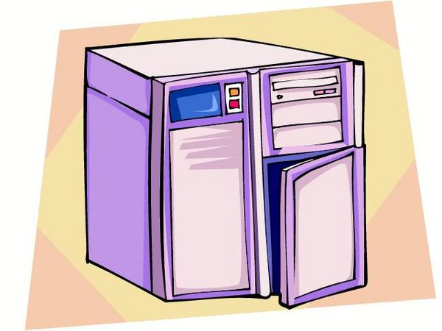

DNS
1. What is the IP address of udel.edu ?
It is 128.175.13.92
1. What is the host name of 128.175.13.74
It is strauss.udel.edu

Slide 4
25-1 NAME SPACE
To be unambiguous, the names assigned to machines must be carefully selected from a name space with complete control over the binding between the names and IP addresses.
Topics discussed in this section:
Flat Name Space
Hierarchical Name Space
25.<number>

Slide 5
25-2 DOMAIN NAME SPACE
To have a hierarchical name space, a domain name space was designed.
In this design the names are defined in an inverted-tree structure with the root at the top.
The tree can have only 128 levels: level 0 (root) to level 127.
Topics discussed in this section:
Label
Domain Name
Domain
25.<number>

Slide 6

Figure 25.2 Domain name space
25.<number>

Slide 7

Figure 25.3 Domain names and labels
25.<number>

Slide 8

Figure 25.4 FQDN and PQDN
25.<number>

Slide 9

Figure 25.5 Domains
25.<number>

Slide 10
25-3 DISTRIBUTION OF NAME SPACE
The information contained in the domain name space must be stored.
However, it is very inefficient and also unreliable to have just one computer store such a huge amount of information.
In this section, we discuss the distribution of the domain name space.
Topics discussed in this section:
Hierarchy of Name Servers
Zone
Root Server
Primary and Secondary Servers
25.<number>

Slide 11

Figure 25.6 Hierarchy of name servers
25.<number>

Slide 12

Figure 25.7 Zones and domains
25.<number>

Slide 13
Primary and Secondary Servers
DNS defines two types of servers: primary and secondary.
A primary server is a server that stores a file about the zone for which it is an authority.
It is responsible for creating, maintaining, and updating the zone file. It stores the zone file on a local disk.
A secondary server is a server that transfers the complete information about a zone from another server and stores the file on its local disk.
The secondary server neither creates nor updates the zone files.
If updating is required, it must be done by the primary server, which sends the updated version to the secondary
25.<number>

Slide 14

Note
A primary server loads all information from the disk file; the secondary server
loads all information from
the primary server.
When the secondary downloads
information from the primary, it is called zone transfer.
25.<number>

Slide 15
25-4 DNS IN THE INTERNET
DNS is a protocol that can be used in different platforms.
In the Internet, the domain name space (tree) is divided into three different sections: generic domains, country domains, and the inverse domain.
Topics discussed in this section:
Generic Domains
Country Domains
Inverse Domain
25.<number>

Slide 16

Figure 25.8 DNS IN THE INTERNET
25.<number>

Slide 17

Figure 25.9 Generic domains
25.<number>

Slide 18

Table 25.1 Generic domain labels
25.<number>

Slide 19
Country Domains
The country domains section uses two-character country abbreviations (e.g., us for United States).
Second labels can be organizational, or they can be more specific, national designations.
The United States, for example, uses state abbreviations as a subdivision of us (e.g., ca.us.).
Figure 25.10 shows the country domains section.
The address anza.cup.ca.us can be translated to De Anza College in Cupertino, California, in the United States.
25.<number>

Slide 20

Figure 25.10 Country domains
25.<number>

Slide 21
Inverse Domain
The inverse domain is used to map an address to a name.
This may happen, for example, when a server has received a request from a client to do a task.
Although the server has a file that contains a list of authorized clients, only the IP address of the client is listed.
The server asks its resolver to send a query to the DNS server to map an address to a name to determine if the client is on the authorized list.
This type of query is called an inverse or pointer (PTR) query.
To handle a pointer query, the inverse domain is added to the domain name space with the first-level node called arpa.
The second level is also one single node named in-addr. The rest of the domain defines IP addresses.
25.<number>

Slide 22

Figure 25.11 Inverse domain
25.<number>

Slide 23
25-5 RESOLUTION
Mapping a name to an address or an address to a name is called name-address resolution.
Topics discussed in this section:
Resolver
Mapping Names to Addresses
Mapping Addresses to Names
Recursive Resolution
Caching
25.<number>

Slide 24
Resolvers
A Resolver maps a name to an address and vice versa.
Query
Response
Resolver
Name Server

Slide 25

Figure 25.12 Recursive resolution
25.<number>

Slide 26

Figure 25.13 Iterative resolution
25.<number>

Slide 27
25-6 DNS MESSAGES
DNS has two types of messages: query and response. Both types have the same format. The query message consists of a header and question records; the response message consists of a header, question records, answer records, authoritative records, and additional records.
Topics discussed in this section:
Header
25.<number>

Slide 28
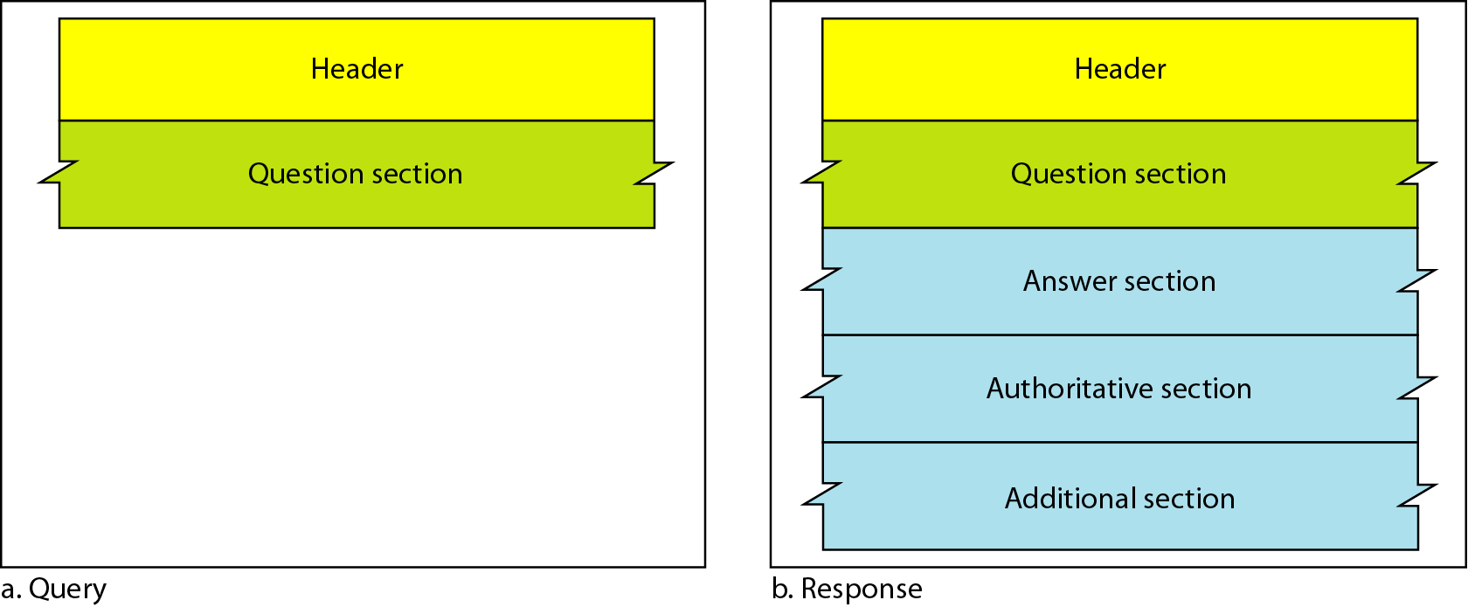
Figure 25.14 Query and response messages
25.<number>

Slide 29
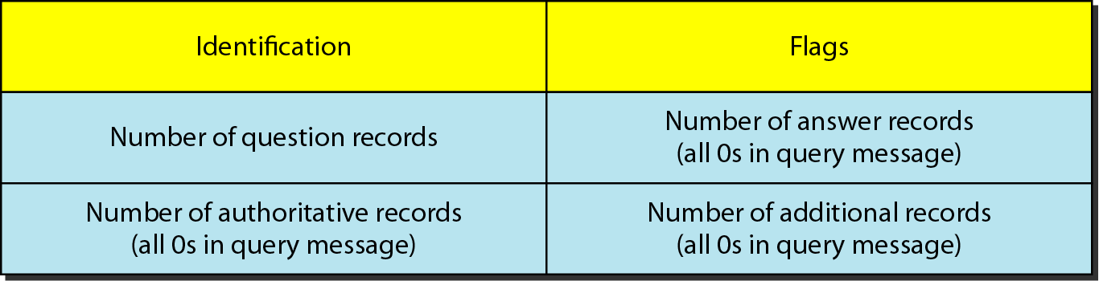
Figure 25.15 Header format
25.<number>

Slide 30
25-7 TYPES OF RECORDS
As we saw in Section 25.6, two types of records are used in DNS. The question records are used in the question section of the query and response messages. The resource records are used in the answer, authoritative, and additional information sections of the response message.
Topics discussed in this section:
Question Record
Resource Record
25.<number>

Slide 31
25-8 REGISTRARS
How are new domains added to DNS? This is done through a registrar, a commercial entity accredited by ICANN. A registrar first verifies that the requested domain name is unique and then enters it into the DNS database. A fee is charged.
25.<number>

Slide 32
25-9 DYNAMIC DOMAIN NAME
SYSTEM (DDNS)
The DNS master file must be updated dynamically. The Dynamic Domain Name System (DDNS) therefore was devised to respond to this need. In DDNS, when a binding between a name and an address is determined, the information is sent, usually by DHCP to a primary DNS server. The primary server updates the zone. The secondary servers are notified either actively or passively.
25.<number>

Slide 33
25-10 ENCAPSULATION
DNS can use either UDP or TCP. In both cases the well-known port used by the server is port 53. UDP is used when the size of the response message is less than 512 bytes because most UDP packages have a 512-byte packet size limit. If the size of the response message is more than 512 bytes, a TCP connection is used.
25.<number>

Slide 34
Note
DNS can use the services of UDP or TCP using the well-known port 53.
25.<number>

